Slide 1
Comparing Models on COVID-19 Tweets
Eliana Mugar & Sam Rigor

Slide 2
Najoung’s Feedback
Sounds interesting! A few concerns that would need to be addressed in the final report:
What exactly is your novel contribution here? e.g., what would you find that you wouldn't find with running an experiment with a random subset of the COV19Tweets dataset? I'm assuming the diversity in opinion, source/user, and timeframe would be what differentiates it, but I am not sure how this ties into the overarching goal that you describe in the final paragraph.
How exactly would you go about filtering the dataset to 500-1000 tweets, meeting the constraints that you described? The process and design decisions should be well documented in the final report.

Slide 3
Background
In recent years, younger people have been using social media as a news source
Though social media can make information accessible to a wide audience,

Slide 4
Previous Work
In recent years, researchers have already developed datasets to train ML models to detect misinformation
“ANTi-Vax: a novel Twitter dataset for COVID-19 vaccine misinformation detection”
“CoAID: COVID-19 Healthcare Misinformation Dataset”

Slide 5
Task Description & Metrics
Are models able to correctly identify whether or not social media posts contain misinformation regarding COVID-19?
Models used (both from HuggingFace):
spencer-gable-cook/COVID-19_Misinformation_Detector
roupenminassian/TwHIN-BERT-Misinformation-Classifier
Both of these models use binary classification
0 = NOT misinformation
1 = misinformation
That being said, we can use accuracy, precision, recall, and F1 to evaluate model performance

Slide 6

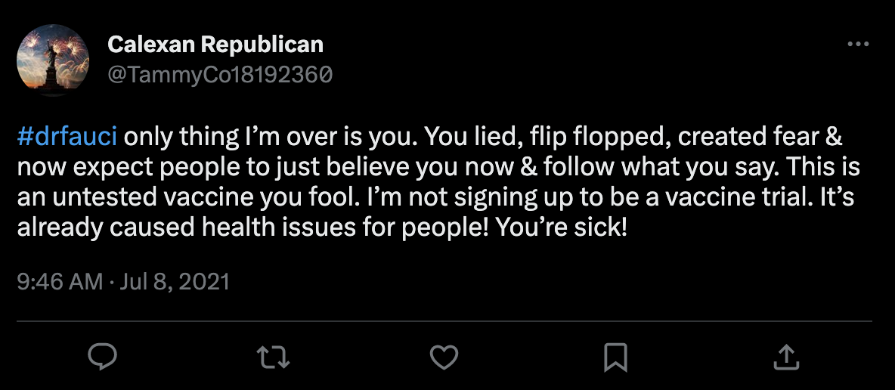
Dataset Description
Tweets mentioning COVID-19 in some way
Example terms: “nCov,” “Pfizer,” “vaccine,” “corona”
Existing datasets are too large → randomly select N=1,000 tweets from the data
0 = NOT misinformation
1 = misinformation

Slide 7
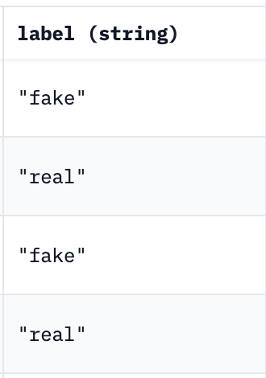
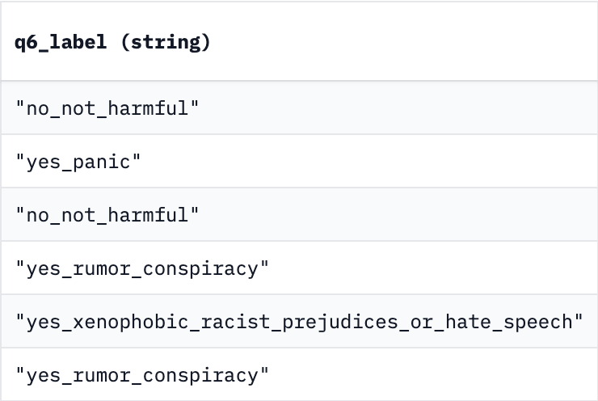
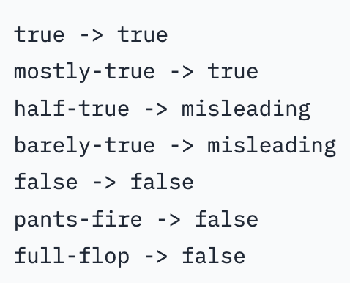
Data Sources
COVID-19 Tweet datasets with different scales
nanyy1025/covid_fake_news
arbml/COVID_19_Disinformation_ar
justinqbui/covid_fact_checked_polifact

Slide 8
Limitations
There are multiple COVID-19 Tweet datasets
However, they are often large— hard to load into Colab and Jupyter Notebook
Annotations may be incorrect— need to find a viable way to hand-label whether the Tweet is misinformation or not

Slide 9
Bibliography
https://www.sciencedirect.com/science/article/pii/S0033350621004534
https://arxiv.org/abs/2006.00885
https://www.kaggle.com/datasets/gpreda/covid19-tweets
https://huggingface.co/datasets/arbml/COVID_19_Disinformation_ar
https://huggingface.co/datasets/justinqbui/covid_fact_checked_polifact
https://huggingface.co/datasets/nanyy1025/covid_fake_news
https://huggingface.co/spencer-gable-cook/COVID-19_Misinformation_Detector
https://huggingface.co/ChrisEsworthy/Covid_Misinformation_Model

